Slide 1
DATA DRIVEN rendering
3DCC PROJECT SLIDES

Slide 2

The importance of renderers
KD/OCT TREE, Node Hierarchy
GAME TOOLS, EDITOR
Level/NPC/Terrain/FX Renderer
Input, Physics, Audio
Game Engine
Game Specific Systems
GAME DATA/SCRIPT
Gameplay/Script Execution
Game Executable

Slide 3
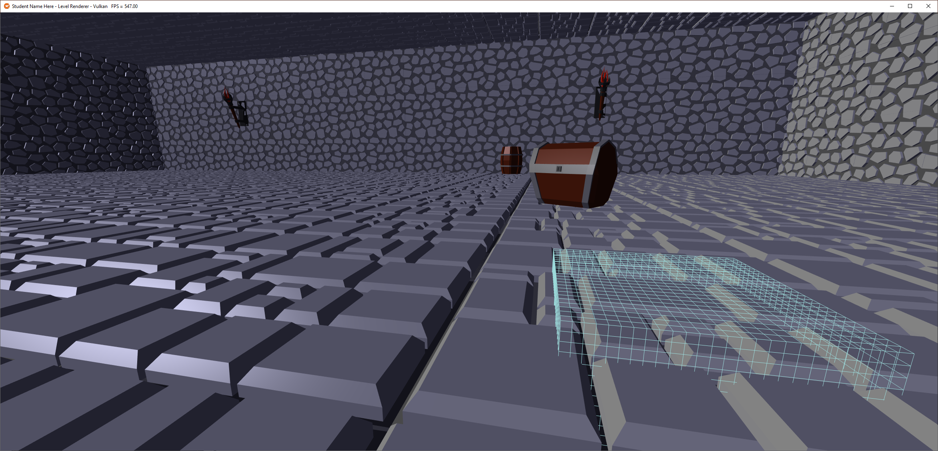
The level renderer

Slide 4
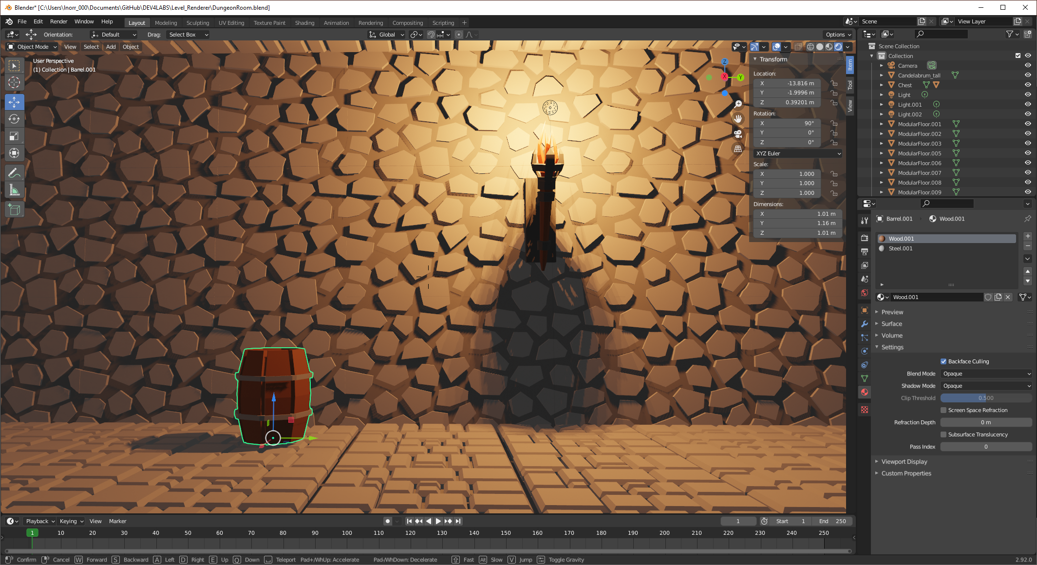
THE LEVEL EDITOR

Slide 5
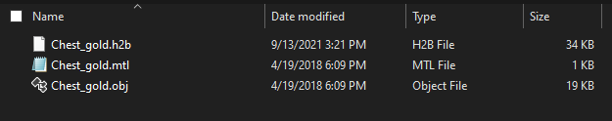
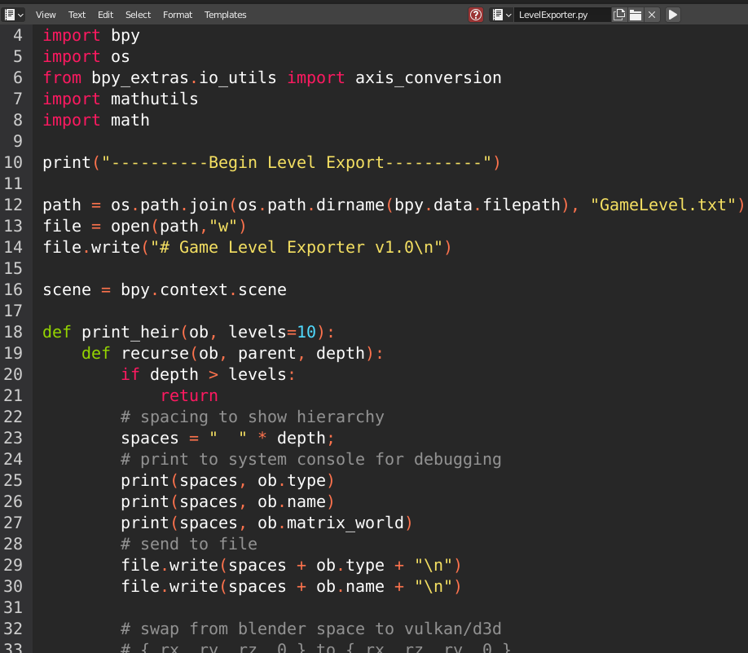
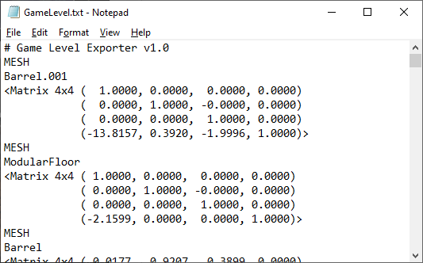
THE LEVEL DATA

Slide 6
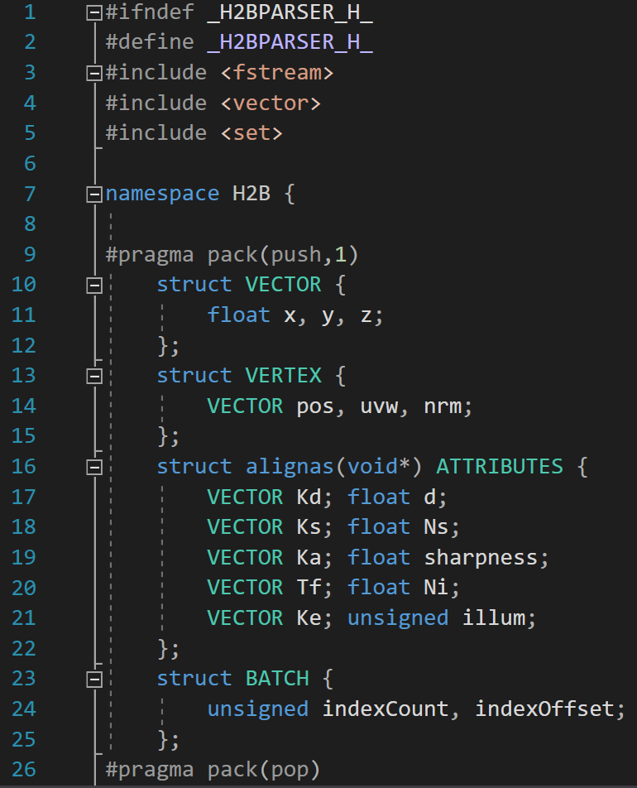
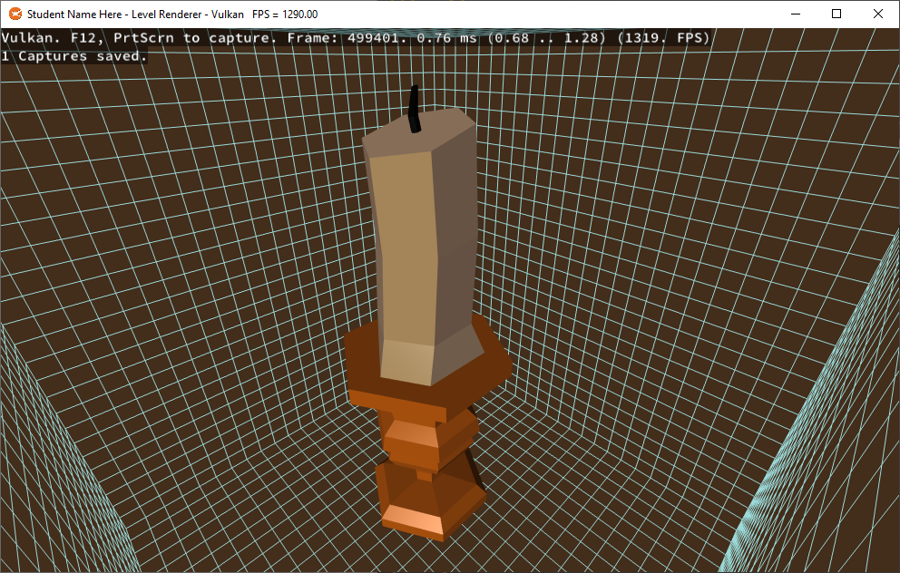
THE LEVEL tools & Executable

Slide 7
Object oriented approach
Create “Model” class:
Has a vertex/index buffer, A Parser, Its own SHADER_VARIABLE_STRUCT (Assignment 2).
Each model will also contain a way to store its uniforms (Ex: storage/constant buffer).
Models also have their own Shaders, Pipelines, Layouts, Anything required for drawing.
Transfer assignment 2’s API specific loading & drawing code to the Model class.
The Renderer becomes a RenderingManager class, that has a list of Models.
Inside this class you add one model for each one found in the Game’s Level.
For each model found, Load data from .h2b file onto the CPU, populate any uniforms.
You then ask each model to independently Upload(), Draw() and Release() itself.

Slide 8
Object oriented considerations
pros
cons
Easier for those used to OO code
Models are “self-contained” to a degree
Requires little pre-planning
Everything is assumed to be one-by-one
Arguably the fastest to start with
Fewest adjustments to Assignment 2’s shaders & buffers
Poor performance ceiling
Lack of simple instancing support
Memory Inefficient
Significant amounts of duplicated data
Generally Inflexible design
Data and Logic are coupled

Slide 9
Data oriented approach
Load All Unique Models into a “Level_Data” class:
One array each for all combined Vertices, Indices, Material, Meshes, etc...
Each model encountered is recorded as an Instance.
Only new models copy data to the arrays, each instance is a collection of offsets & size.
Upload all unique mesh/material data to one storage/structured buffer.
Create separate uniform/constant buffers for globals and instance matrices.
Use the offset/instance features of the API to draw each batch only once.

Slide 10
DATA oriented considerations
pros
cons
Strong Performance
Instancing makes a massive difference
Memory Efficient
Only unique data is uploaded
More Flexible design
Data and Logic are de-coupled
Everything is somewhere in an array
Confusing when things go wrong
Requires LOTS of pre-planning
You need to organize your data well
Significant API familiarity required
Might as well start fresh or with Assignment 1 as a base

Slide 11
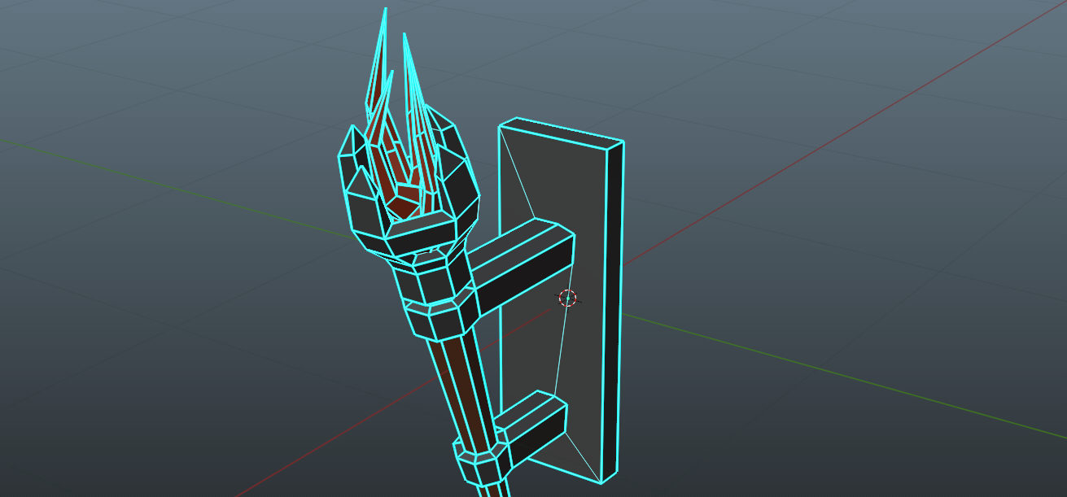
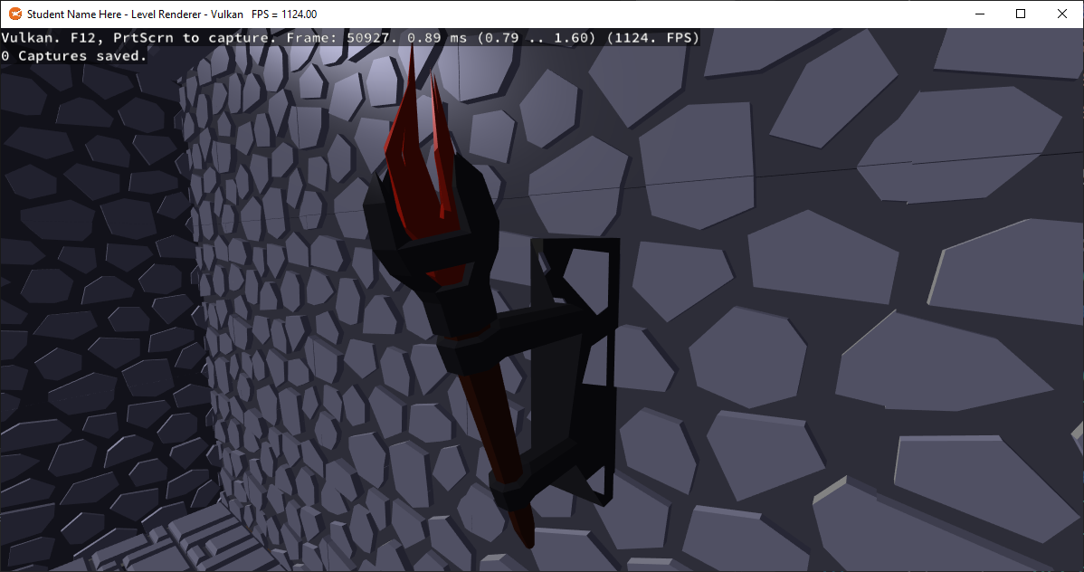
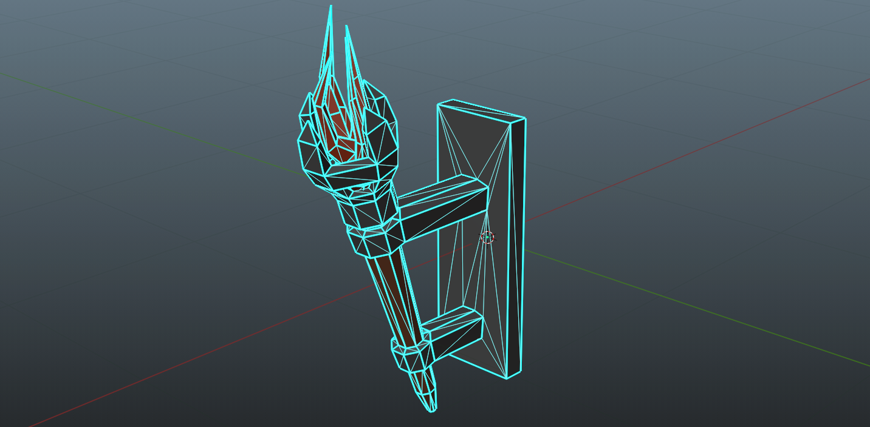
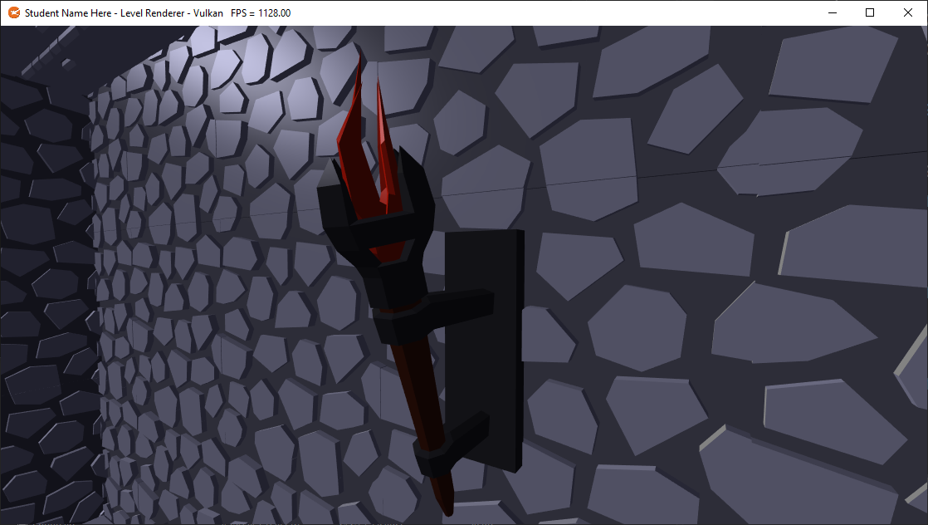
Lessons learned
N-POLYS
TRIANGLES

Slide 12
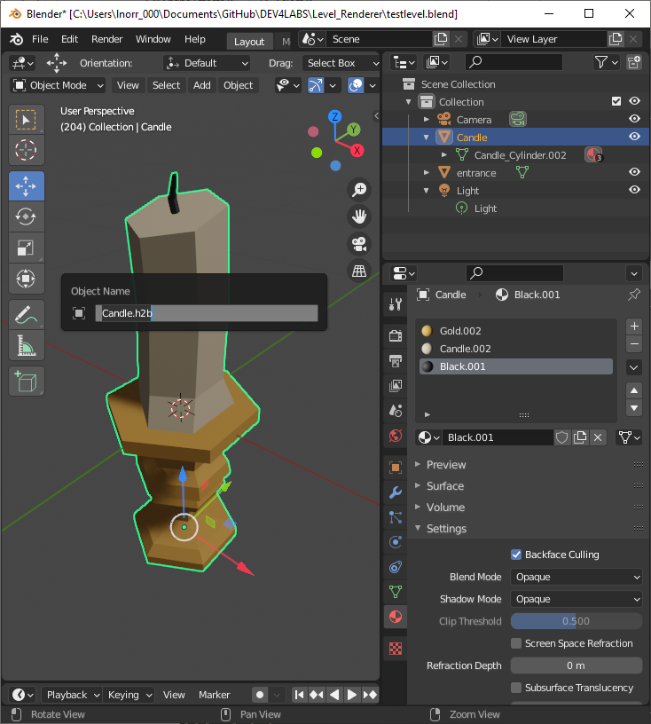
Remember
Triangulate your models before use
Blender has the Y and Z axis swapped
OBJ files may not retain their file name when imported, rename them for export
Blender has a first-person view + gravity, great for walking the level
You can preview lights & materials by switching the viewport shading
Back-face culling is OFF by default in Blender but ON by default in most APIs

Slide 13
Programming presentation
uploading object-oriented level resources to the GPU

Slide 14
Q

Slide 15
PLACEHOLDER: OO Diagram

Slide 16
PLACEHOLDER: DO Diagram

Slide 17

building & exporting our first level

